Slide 1


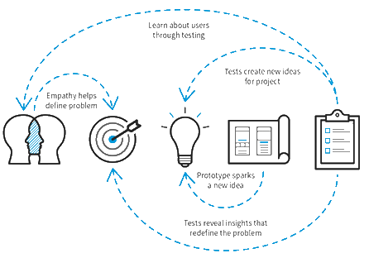
Design Thinking and Innovation

Slide 2
Title of the Project
RFID-Library System
BATCH NO : B3
Name | Reg. Number
Mentor
Dr. A. Sampath Dakshina Murthy
Senior Associate Professor
Head Vignan’s Centre for Innovations & Startups

Slide 3
Contents
Abstract
Graphical Abstract
Problem Identification
Proof of Concept (PoC)
Validation
Design Thinking Process Overview
Empathize
Define
Ideate
Prototype
Test
Proposed Innovative Solution
Target Beneficiaries
Components Required/Software tools
Technology Readiness Levels (TRL)
Challenges
Output of the Project
Video link
Poster
Output Images
Conclusion
Future scope
References

Slide 4


